Slide 1
Happy Eyeballs for the DNS
Geoff Huston,
George Michaelson
APNIC Labs
October 2015

Slide 2
Recap: “Happy Eyeballs”
Plan A:
If you are Dual Stack and the service you are attempting to connect to is Dual Stack then try to connect using V6 first, and if the connection attempt fails then try using V4
  Which “naturally” propels the V6 transition – as more clients and services support Dual Stack then more transactions will shift to use V6

Slide 3
Recap: “Happy Eyeballs”
But Connection Failure took forever:
  Windows: 21 seconds
  BSD: 75 seconds
  Linux: 189 seconds
So what we wanted in the Web was a “fast fail” to keep the eyeballs on the content

Slide 4
Recap: “Happy Eyeballs”
Plan B:
If you are Dual Stack and the service you are attempting to connect to is Dual Stack then try to connect using both protocols, but give V6 a (small) head start
  The V6 SYN is typically given a head start of 300ms over the V4 SYN, and the first protocol to complete the TCP handshake is used for the ensuing session

Slide 5
Happy DNSballs?
00003.y.dotnxdomain.net. IN NS ns1.00003.y.dotnxdomain.net.
ns1.00003.y.dotnxdomain.net. IN A 162.223.8.90
IN AAAA 2607:fc50:1001:9500::2
  This zone is served by an authoritative name server that has both a V4 and a V6 address
How should a “Happy Eyeballs” DNS resolver behave?
How do resolvers behave today?

Slide 6
Fast Failover in the DNS?
Plan A:
Wait for timeout?
Resolver timeout / retry algorithm is specific to the DNS resolver implementation:
RFC1034:
“Send them queries until one returns a response.”

Slide 7
Observed DNS Resolver Re-Query Times
0.37 Second Retry
0.8 Second Retry
1 Second Retry

Slide 8
Fast Failover in the DNS?
If the DNS were to behave like the Web:
  assemble a sorted list of V4 and V6 addresses
  launch a query to the “best” V6 server
  wait for <small time>
  launch a query to the “best” V4 server
But this is not what typically happens today.
What does happen?
Where <small time> is around the order of an expected RTT for the query

Slide 9
Measuring DNS Resolver Behaviour

Slide 10
Aside: Understanding DNS Resolvers is “tricky”
What we would like to think happens in DNS resolution!
x.y.z?
x.y.z?
Authoritative
Nameserver
Client
DNS Resolver
x.y.z? 10.0.0.1
x.y.z? 10.0.0.1

Slide 11
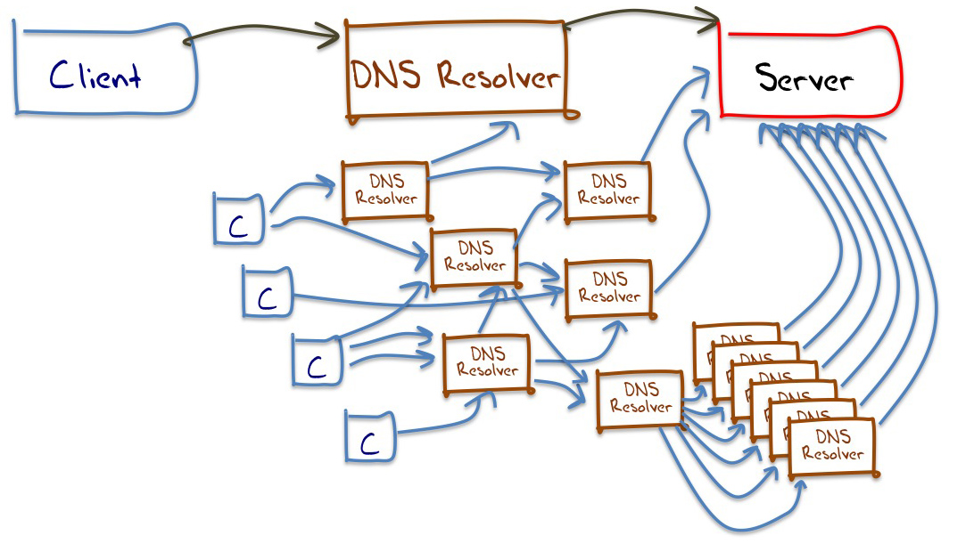
Aside: Understanding DNS Resolvers is “tricky”
A small sample of what appears to happen in DNS resolution

Slide 12
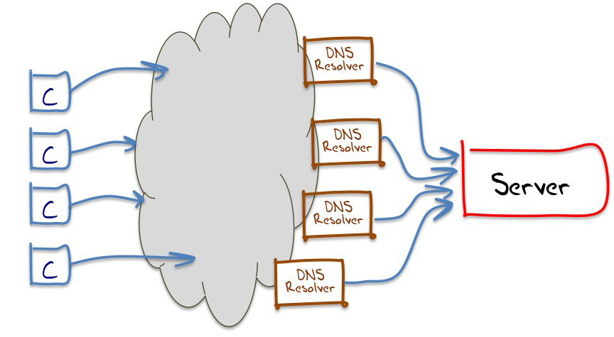
Aside: Understanding DNS Resolvers is “tricky”
We can measure the DNS resolution of these clients
We can measure the behaviour of these resolvers
All this DNS resolver
infrastructure is opaque
The best model we can use for DNS resolution in these experiments

Slide 13
Aside: Understanding DNS Resolvers is “tricky”
We can measure the DNS resolution of these clients
We can measure the behaviour of these resolvers
All this DNS resolver
infrastructure is opaque
Maybe we can improve on this
The best model we can use for DNS resolution in these experiments

Slide 14
Glueless Delegation

Slide 15
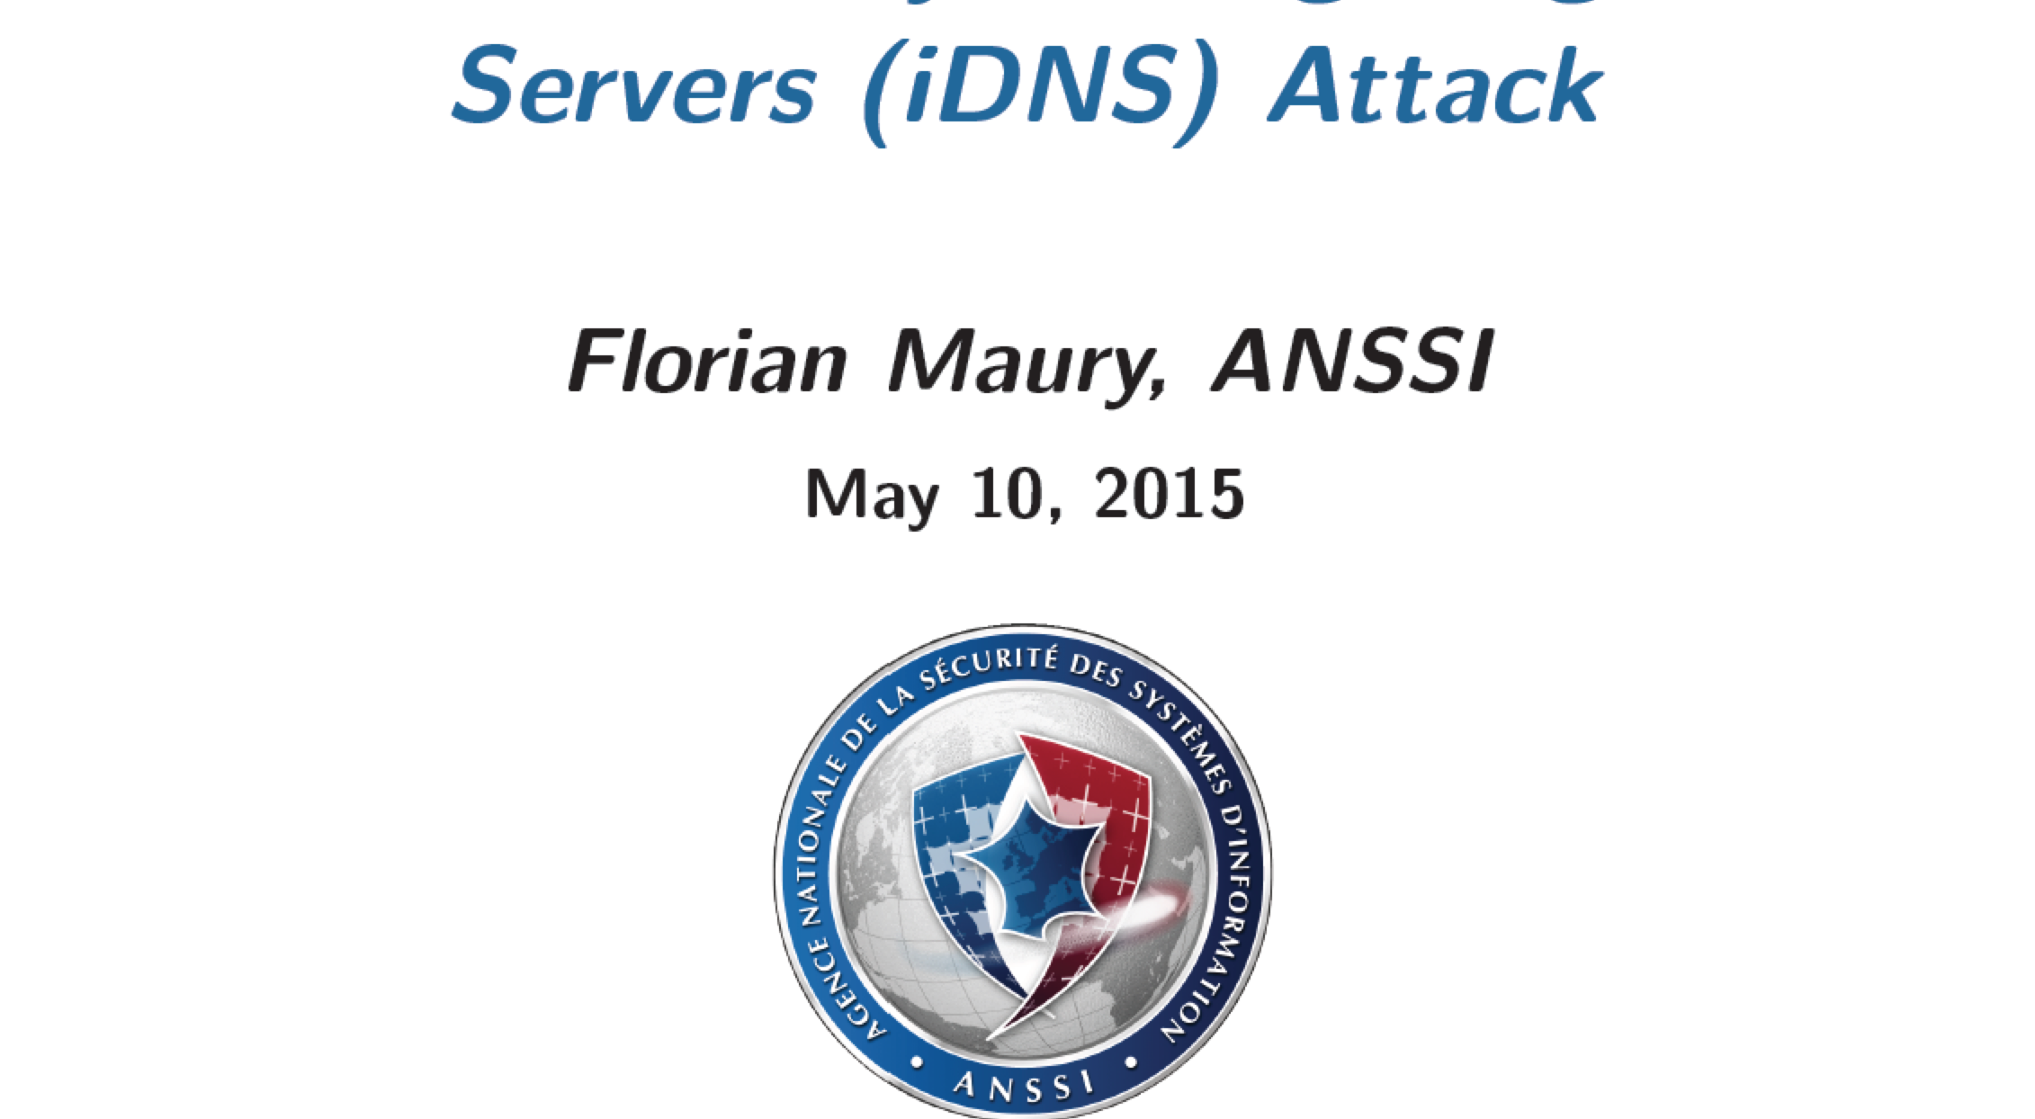
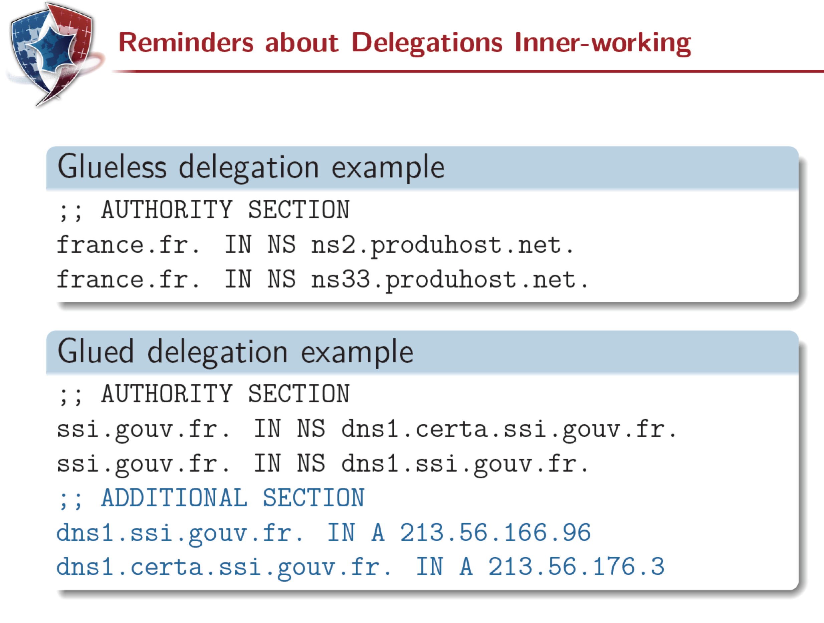
Glueless Delegation
DNS OARC 2015 Spring Workshop

Slide 16
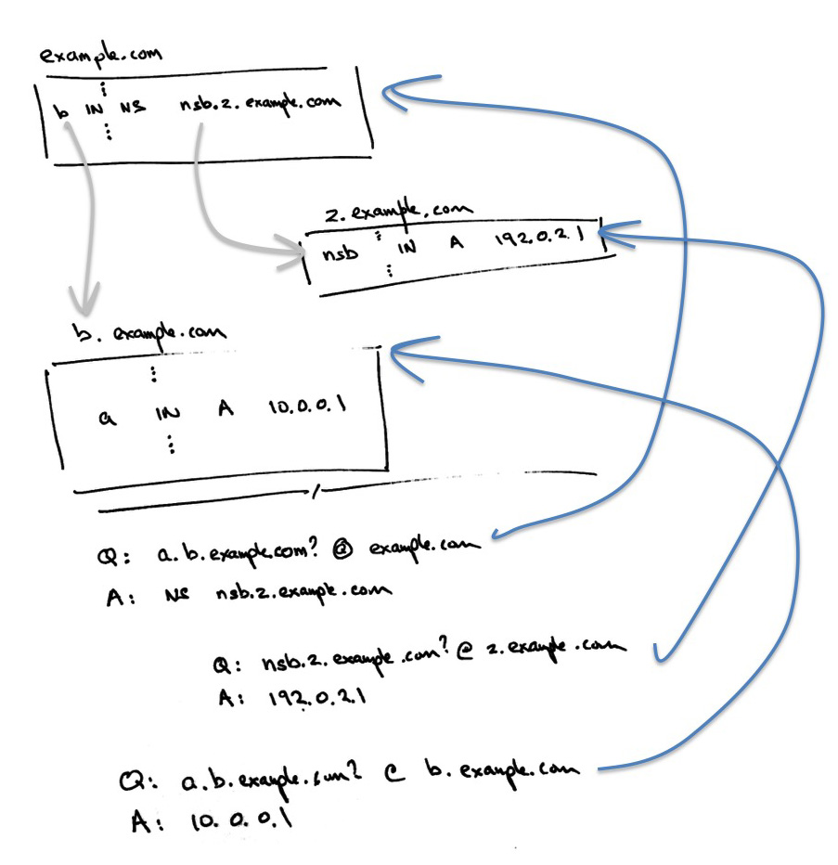

Slide 17
The resolver can only ask
question 3 if it receives answer 2
1
2
3

Slide 18
Glueless Delegation
We can change the behaviour of the DNS response to the NS domain query
And we observe that the resolver has received the response by the subsequent query to the child domain

Slide 19
Testing V6 Preference in the DNS
We set up three domain structures:
  Glueless V4 only - NS name has only an A RR
  Glueless V6 only – NS name has only a AAAA RR
  Glueless Dual Stack – NA name has both A and AAAA RRs
And tested this in an online Ad campaign using a pool of unique names to circumvent DNS name caching in resolvers

Slide 20
The Experiment
25 July 2015 – 31 August 2015
43,679,222 completed experiments
Web results:
DNS V4 Only 42,515,729 97%
DNS V6 Only 16,605,301 38%
DNS Dual Stack 41,653,531 95%
38% of tests involved using DNS resolvers that were able to perform DNS queries over IPv6

Slide 21
The Experiment
25 July 2015 – 31 August 2015
43,679,222 completed experiments
Web results:
DNS V4 Only 42,515,729 97%
DNS V6 Only 16,605,301 38%
DNS Dual Stack 41,653,531 95%
38% of tests involved using DNS resolvers that were able to perform DNS queries over IPv6
So if resolvers were “neutral” with respect to A and AAAA RRs in name servers, then we would see approximately 19% of queries to the Dual Stack structure take place over IPv6 – yes?

Slide 22
DNS Query Behaviours per Experiment
Number of experiments that had >= 1 DNS query observed at the server
Experiment
Behaviour Total
V4 only 38,104,161
V6 only 15,116
V4 and V6 29,546,165
Yes, that’s a total of 67,665,443 experiments in the DNS, while only 43,679, 222 completed the web fetch cycle (64% completion rate)

Slide 23
DNS Query Behaviours per Experiment
Experiment
Behaviour Total
V4 only 38,104,161
V6 only 15,116
V4 and V6 29,546,165
Dual Stack DNS object fetch behaviour
Exclusively used V4: 24,257,143 82%
Exclusively used V6: 1,982,312 7%
Used V4 and v6: 3,193,945 11%

Slide 24
DNS Queries
Resource v4 Queries v6 Queries
4-only 110,265,765 0
6-only 0 61,601,964
Dual-stack 101,897,693 7,346,050
Total number of DNS queries for A and AAAA
RRs seen at the authoritative server for
The DNS name

Slide 25
DNS Queries
Resource v4 Queries v6 Queries
4-only 110,265,765 0
6-only 0 61,601,964
Dual-stack 101,897,693 7,346,050
In a glueless structure we saw 7% of queries for a dual stack resource. From the Web results we were expecting something closer to 19%

Slide 26
DNS Resolvers
Let’s switch from the queries make by resolvers to the visible resolvers themselves
Resolvers seen:
IPv4-Only Resolvers:
IPv6-Only Resolvers:
Dual Stack Resolvers:

Slide 27
Aside: Identifying DNS Dual Stack Resolvers
Identifying a resolver as a dual stack resolver involves some assumptions, as the logged queries do not implicitly reveal that a V4 and a V6 address are actually addresses of the same resolver:
  If a test query set involved a single V4 and single V6 address then I tentatively “join them” to a single resolver
  6-to-4 addresses are “joined” to each other
  Loops are preferred
  If a v4 address is “joined” to multiple V6 addresses in this way (or vv) then I undo the join except in those cases where the V4 and V6 addresses share a common final octet/nibble
a.b.c.15
d::15
e.f.g.20

Slide 28
DNS resolvers
Let’s switch from the queries make by resolvers to the visible resolvers themselves
Resolvers seen: 464,950
IPv4-Only Resolvers: 446,173 (96%)
IPv6-Only Resolvers*: 11,377 ( 2%)
Dual Stack Resolvers: 7,040 ( 2%)
* Could not uniquely associate the IPv6 address with a single IPv4 address

Slide 29
DNS Dual Stack Resolvers
282 dual stack resolvers use 6-to-4 for their IPv6 connections
  None of these resolvers prefer IPv6 when querying a dual stack auth server
4 dual stack resolvers used Teredo (!)
  They made a mix of V4 and V6 queries (63% v4)
6,759 dual stack resolvers used non-mapped V6 addresses
  58% of queries using V4, 42% using V6

Slide 30
DNS Dual Stack resolvers
Lets look the queries made by the visible dual stack resolvers:
Dual Stack Resolvers: 7,290
Always Prefer 4: 1,074 (15%)
Always Prefer 6: 197 ( 3%)
Mixed: 6,001 (82%)
Did not query DS name: 18 ( 0%)

Slide 31
DNS V6 Capable resolvers
V6 Capable Resolvers: 18,421
Did not use V6 for Dual Stack: 5,088 (28%)
Always Preferred V6: 1,458 ( 8%)
Mixed V6/V4 for Dual Stack: 11,875 (64%)
Of the mixed V4/V6 situation V6 was used to resolve the dual stack glue record for 5,651,796 identifiers of a total of 38,782,137 identifiers, or 15% of the time

Slide 32
DNS Protocol Switch Times

Slide 33
DNS Protocol Switch Times

Slide 34
What Does Google’s Public DNS Do?
Observed V6 resolver addresses for Google PDNS: 566
Observed preference for V6 dual stack: 0
(using glueless delegation)

Slide 35
What does Bind Do?
Can we see Bind?
  Well, as far as I am aware (please correct me) Bind is the only resolver that will not follow a CNAME in a NS record
  So lets use that as a working definition for Bind and see what Bind does

Slide 36
What does Bind do?
Experiments using dual stack BIND resolvers:
Asked for Dual Stack using V4: 4,075,246 (52%)
Asked for Dual Stack using V6: 690,566 (17%)
Asked for Dual Stack using V4 and V6: 1,263,312 (31%)

Slide 37
What does Bind do?
Number of resolvers: 264,501 of 479,468 (55%)
  (These are the resolvers who do not follow a CNAME RR)
Compare V4 only to V4 Dual Stack
Used IPv4 to query a dual stack resource: 123,339 / 136,946 (90%)
Compare V6 only to V6 Dual Stack
Used IPv6 to query a dual stack resource: 9,402 / 11,950 (79%)

Slide 38
What does NON-Bind do?
Experiments using dual stack NON-BIND resolvers:
Asked for Dual Stack using V4: 22,135,775 (87%)
Asked for Dual Stack using V6: 1,291,746 ( 5%)
Asked for Dual Stack using V4 and V6: 1,930,633 ( 8%)

Slide 39
What does NON-Bind do?
Number of resolvers: 214,967 of 479,468 (45%)
  (These are the resolvers who do follow a CNAME RR)
Compare V4 only to V4 Dual Stack
Used IPv4 to query a dual stack resource: 136,039 / 139,834 (98%)
Compare V6 only to V6 Dual Stack
Used IPv6 to query a dual stack resource: 2,554 / 2,693 (94%)

Slide 40
Happy DNS Eyeballs?
Not really.
Only 4% of resolvers appear to be dual stack capable ☹
And of those that do, they are not favoring IPv6 over IPv4 ☹
And there is not clear evidence of the use of a fast failover approach from IPv6 to IPv4 ☹

Slide 41
Does it matter?
How can you tell when you no longer need to keep running IPv4 on an authoritative name server?
  When there are no longer any queries made using IPv4
But this answer assumes that dual stack resolvers have a clear preference to use IPv6 first and perform a fast failover to IPv4
Which is not happening today in the DNS ☹

Slide 42
That’s it!

